Slide 1
Baseball Projection
Shuxin Chen, Feiran Yang

Slide 2
Goals of the project
To predict the next game’s performance of a certain baseball player based on historical data
wRC+(Weighted Runs Created Plus) = (((wRAA per PA + league runs per PA) + (league runs per PA - ballpark factor x league runs per PA) / league wRC per plate appearance, not including pitchers)) x 100
Notes:
Avg Credits hitter for the value of each outcome

Slide 3
Use cases to be satisfied for hypothetical customers
A baseball coach can use the prediction to：
choose players
make a more targeted training plan for players

Slide 4
Scale
190K records
30 teams in total and each has 25-man roster
162 games in a season
All game logs of every player who is on 25-man rosters excluding pitchers
Notes:
40 25 pitchers

Slide 5
Data sources
http://www.fangraphs.com

Slide 6
Methodology
Pre-Processing
Training Model
Linear Regression
Output Prediction
Analysing Accuracy
Notes:
Pre-process

Slide 7
Load and preprocess data
DataBricks
Based on dataFrame
StringIndexer String type features
Notes:
We use DataBricks to read CSV file. Our Preprocessing is base on dataFrame. Since we decided to use regression to predict, we used StringIndexer to deal with String Type Features

Slide 8
Machine Leaning
Time-series and Linear Regression
Pipeline and Linear Regression
Notes:
For the baseball prediction is like a time-serious question, we planned to use linear Regression at first. And we tried to apply a time-series jar in our project. However, it didn’t work well… So we extract year, month and day as features instead. Also, we used pipeline to make up the lack of accuracy of linear regression

Slide 9
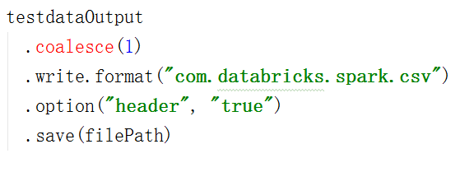
Output and data analysis
Notes:
In order to analyse our predicting results, we output the data and save it as a csv file under the root.

Slide 10
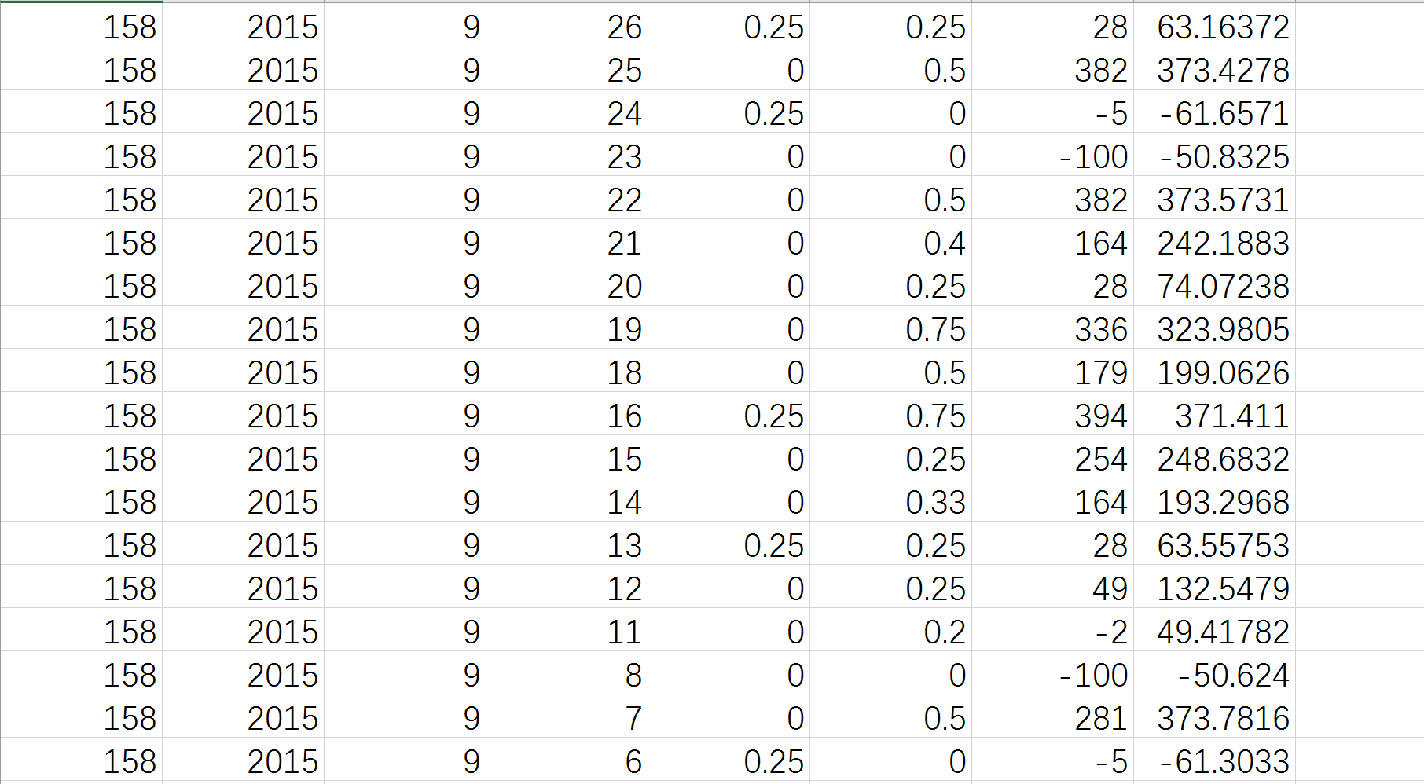
Output CSV File

Slide 11
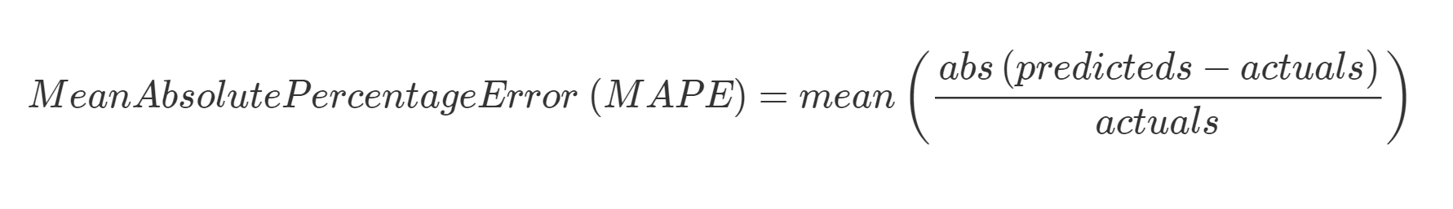
Acceptance criteria
We use mean absolute percentage error to calculate error rate.
We plan to achieve 60%.
Our MAPE is 0.32 -----→68%
Notes:
At first, we selected five features including name, team, time and so on. But the error rate turned out to be very high. So we add three more features. And achieve 68% at lash.

Slide 12
THANK YOU!

